Slide 1
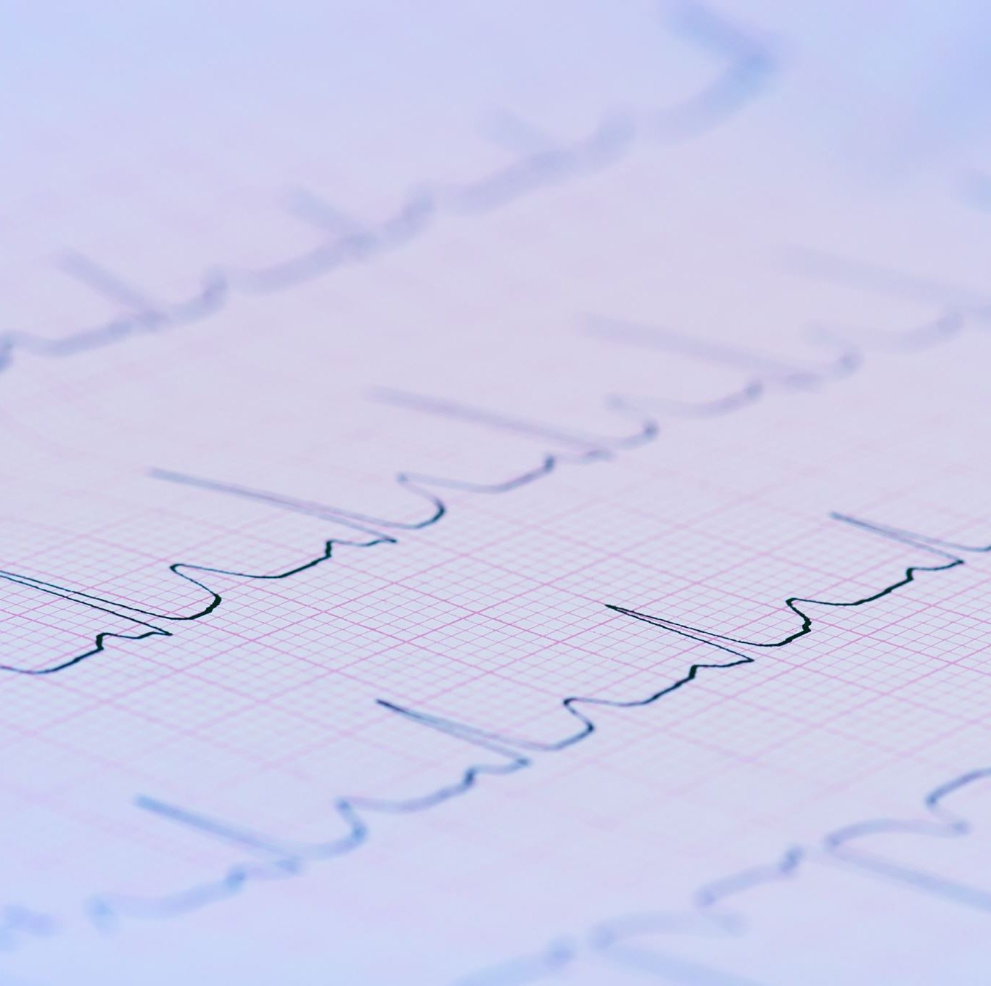
Big Data Platforms
Liver Disease Dataset
Group member:
Lihi Bik
Or Benson

Slide 2

The Problem
In this project, we will use the Liver Disease patient Dataset from Kaggle.
The Dataset contains information such as age, gender, and various clinical and biochemical measurements as well as patients with liver disease and those without.
Our goal is to create a supervised classification algorithm using PySpark that can accurately determine whether a person has liver disease or not.

Slide 3

The Solution
We aim to develop a PySpark-supervised classification algorithm that can accurately identify whether a person suffers from liver disease based on the given features.

Slide 4

Difference
Our solution to liver disease prediction using machine learning differs from existing solutions in several ways. Firstly, we conducted a comprehensive evaluation of various machine learning techniques, including Random Forest Regression, Gaussian Naive Bayes, and Logistic Regression.
Additionally, our study extends previous work in the field by comparing the performance of different techniques on different subsets of the data and investigating their strengths and limitations. We also conducted exploratory data analysis to gain insights into the distribution and relationships between different features in the data.

Slide 5
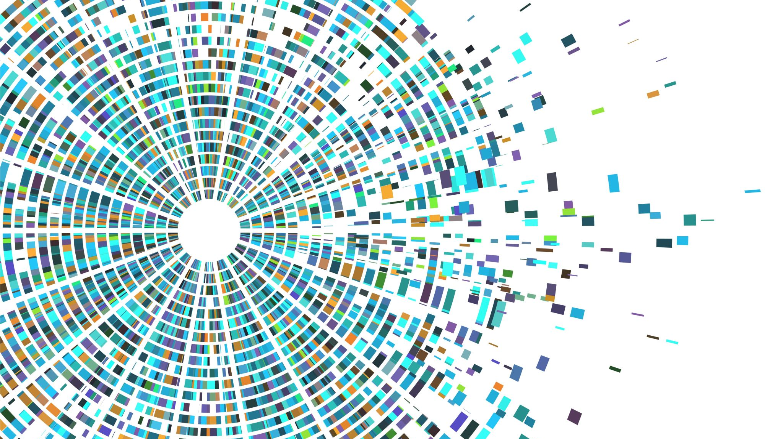
Overview of Machine Learning Approach for Liver Disease Prediction
Our project involves using machine learning techniques to predict liver disease and its progression. We first performed exploratory data analysis (EDA) on the dataset to gain insights into the distribution of features and identify any outliers or missing values.
After selecting the features, we applied several machine learning algorithms, including Random Forest Regression (RFR), Gaussian Naive Bayes (GNB), and Logistic Regression (LR).
To evaluate the performance of our models, we used multiple performance metrics such as accuracy, precision, recall, F1-score, and area under the ROC curve (AUC). We also compared the performance of our models with existing solutions in the field to assess their effectiveness.
Our approach is scalable because it involves using standard machine-learning techniques that can handle large datasets efficiently. The feature classification methods we used are computationally efficient and can handle high-dimensional data. Additionally, our models can be easily updated with new data, allowing for continuous improvement and scalability.

Slide 6
Literature Review
Machine learning has shown great potential in predicting and diagnosing liver disease. A systematic review and meta-analysis by Abeyratne et al. provided an overview of recent research on liver disease prediction using machine learning, and pointed out the limitations of current approaches.
In another study by Aruna et al., a framework for liver disease diagnosis was proposed using machine learning algorithms. The performance of several classifiers, such as Naive Bayes and K-Nearest Neighbor, was compared to determine their effectiveness in predicting liver disease.
Khaliliazar et al. conducted a comparative study of various machine learning algorithms, including Random Forest and K-Nearest Neighbor, for liver disease prediction. They concluded that these methods had the best performance in terms of accuracy and F1-score.
Overall, these studies highlight the potential of machine learning in predicting and diagnosing liver disease. With further research, machine learning algorithms have the potential to improve the accuracy and effectiveness of liver disease diagnosis and treatment.

Slide 7
Databases Overview
Column Name | Data name | Data type
0 | Age of the patient | int
1 | Gender of the patient | string
2 | Total Bilirubin | double
3 | Direct Bilirubin | double
4 | Alkphos Alkaline Phosphotase | int
5 | Sgpt Alamine Aminotransferase | int
6 | Sgot Aspartate Aminotransferase | int
7 | Total Protiens | double
8 | ALB Albumin | double
9 | A/G Ratio Albumin and Globulin Ratio | double
10 | Result | int
The database used in the model for liver disease includes various demographic and laboratory parameters that are commonly used to assess liver function. The age and gender of the patient are recorded as none laboratory parameters . The laboratory parameters include Total Bilirubin (TB), Direct Bilirubin (DB), Alkaline Phosphotase (Alkphos), Alanine Aminotransferase (Sgpt), Aspartate Aminotransferase (Sgot), Total Proteins (TP), Albumin (ALB), and Albumin and Globulin Ratio (A/G).
These parameters are commonly used in the diagnosis and monitoring of liver diseases, and their inclusion in the model can help predict the presence or absence of liver disease based on their values. It is important to note that while these parameters are useful indicators, a diagnosis of liver disease requires a thorough evaluation of the patient's medical history, physical examination, and additional diagnostic tests.

Slide 8
Desired Results
Our desired result is to create a reliable model that accurately predicts the likelihood of liver disease in patients based on their age, gender, and various blood tests values such as Total Bilirubin, Direct Bilirubin, Alkaline Phosphatase, Alanine Aminotransferase, Aspartate Aminotransferase, Total Proteins, Albumin, and Albumin/Globulin Ratio. Achieving high accuracy in the model's predictions will depend on the quality and quantity of the data used to train the model, the feature selection and engineering techniques used to extract the most relevant information from the dataset and the choice of the machine learning algorithm. The ultimate goal is to develop a successful algorithm for early detection and potentially life-saving interventions for patients at risk of liver disease.

Slide 9
Bibliography
"Liver Disease Prediction Using Machine Learning Techniques: A Systematic Review and Meta-Analysis" by V. Abeyratne et al. This paper provides an overview of recent research on liver disease prediction using machine learning and discusses the limitations
"Liver Disease Diagnosis using Classification Algorithms" by S. Aruna et al. This paper proposes a framework for liver disease diagnosis using machine learning algorithms and compares the performance of several classifiers including Naive Bayes, K-Nearest
Artificial Intelligence for Detecting and Quantifying Fatty Liver in Ultrasound Images: A Systematic Review
"Liver disease prediction using machine learning algorithms: a comparative study" by A. Khaliliazar et al. This paper compares the performance of several machine learning algorithms, including logistic regression, support vector machine, decision tree,
A Critical Study of Selected Classification Algorithms for Liver Disease Diagnosis Bendi Venkata Ramana1 , Prof. M.Surendra Prasad Babu2 , Prof. N. B. Venkateswarlu3
An intelligent model for liver disease diagnosis Rong-Ho Lin * Department of Industri
Comparative Study of Data Mining Algorithms in Medical Data

